Slide 1

7COM1079-2022 Student Group No: A115 Names of Student Attendees (all group should attend to get feedback):
1
Group Id: A115 Name of Student Presenting : Sai Golla
Visualization and Analysis -
Tutorial Presentation for Feedback Date: 25/11/2024

Slide 2
Part 1 : Visualization
Significant difference in BMI between different age groups

Slide 3
7COM1079-2022 Student Group ID: A115
We are using the dataset (replace this text with your Kaggle K number and csv file name.) to answer our Research question (replace this text with your RQ …… starting, “Is there a …. ” ¹
3
Age | Height | Weight | Bmi | BmiClass
61 | 1.85 | 109.30 | 31.935720 | Obese Class 1
60 | 1.71 | 79.02 | 27.023700 | Overweight
60 | 1.55 | 74.70 | 31.092612 | Obese Class 1
60 | 1.46 | 35.90 | 16.841809 | Underweight
60 | 1.58 | 97.10 | 38.896010 | Obese Class 2
Notes:
3

Slide 4
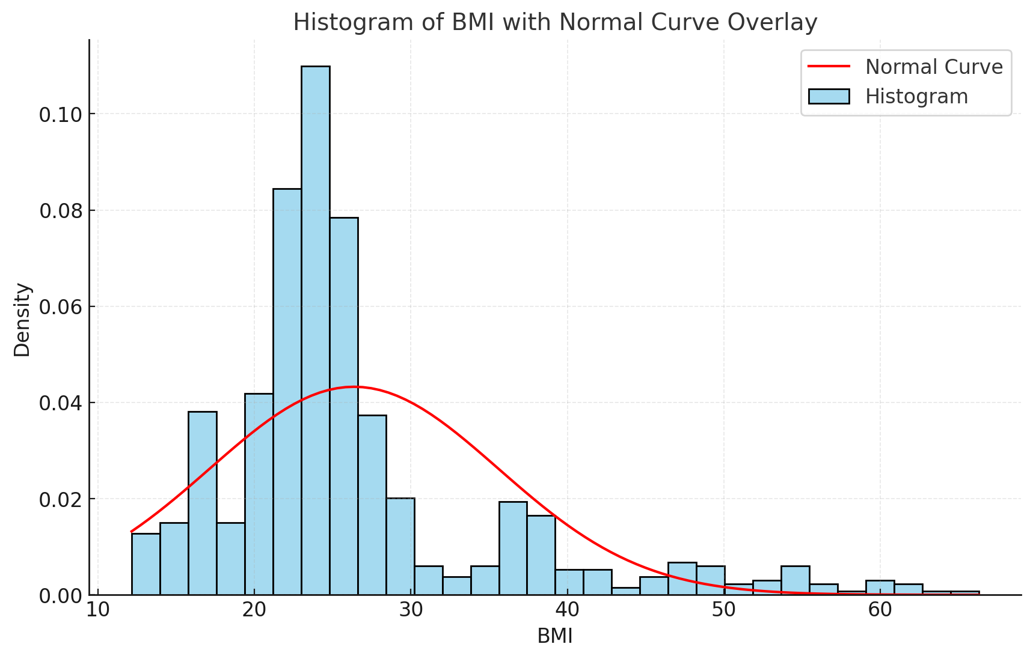
4

Slide 5
PART 2 : Analysis (building on your Visualization)

Slide 6
Here is a table (matrix/cross tabulation) showing our dependent variable as rows, and our independent variable as columns. We have at least two values for both variables that are independent of each other (no overlap).
For example:
Our RQ is about differences in proportions
BMI Class | 15-30 | 31-45 | 46-61
Normal Weight | 224 | 95 | 16
Obese Class 1 | 6 | 2 | 11
Obese Class 2 | 25 | 15 | 13
Obese Class 3 | 38 | 15 | 8
Overweight | 41 | 73 | 52
Underweight | 54 | 22 | 19
6
Notes:
6

Slide 7
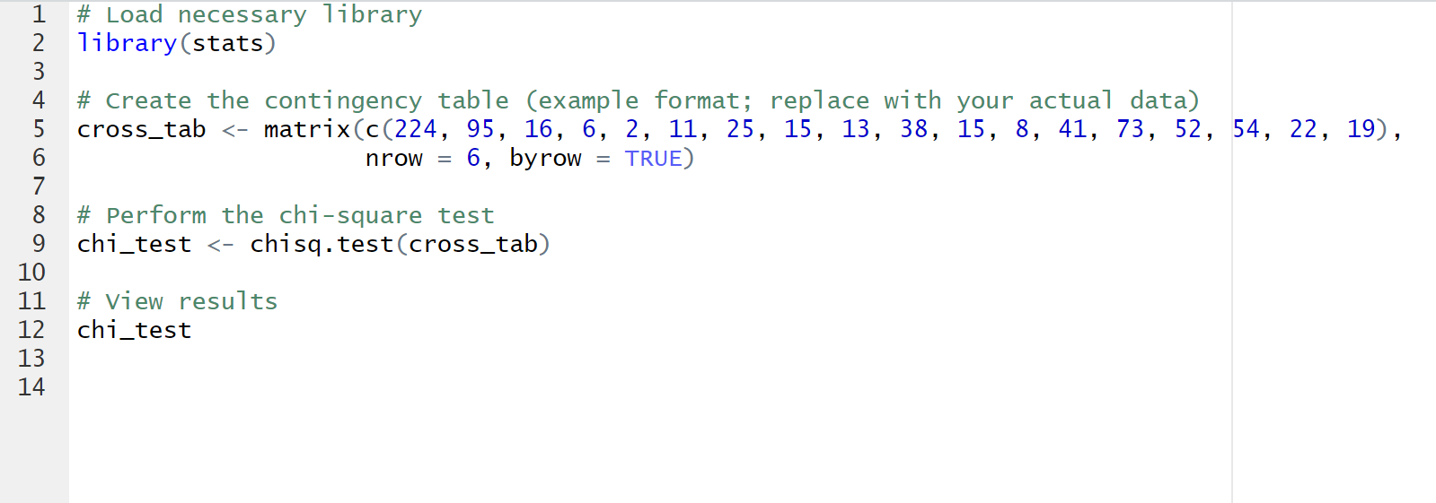
R Script (For ALL types of test) – The Analysis
PRE 7COM1079-2022 Student Group No: ?????
7
Chi-Square Statistic: 129.39, Degrees of Freedom: 10, P-Value: 6.23×10−236.23 \times 10^{-23}6.23×10−23
Notes:
7

Slide 8
Results (For ALL types of test) – The Analysis
p-value is less than 0.05,
The result is statistically significant.
We reject the null hypothesis
Younger individuals are more likely to fall into the "Normal Weight" and "Underweight" categories and Older age groups show higher proportions in the "Overweight" and "Obese" categories.
Therefore, understanding how age influences BMI distribution and can inform targeted public health interventions or awareness programs.

